Slide 1




UNIVERSITY OF PADUA
Mobile content accessibility guidelines
on the Flutter framework
Master Degree in Computer Science Matteo Budai
18 July 2024
ID Number - 2057217 Supervisor - Prof Ombretta Gaggi

Slide 2

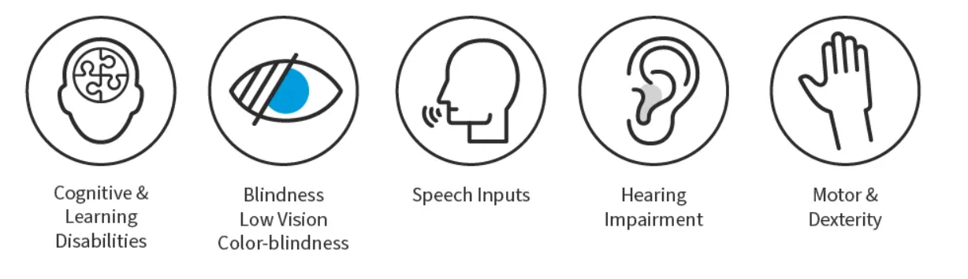
Accessibility
Accessibility = Possibility of accessing information and services available online by diversified categories of users and from a range of different devices
Disadvantages classes:
Sight
Movement
Hearing
Convulsions
Intellect

Slide 3

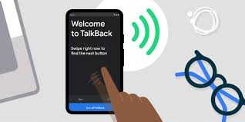

Mobile issues and Legislation
Mobile issues:
Touchscreen interfaces
Small screen sizes
Different input modalities
Device use in different settings …
Useful Events:
Apple’s VoiceOver
Google TalkBack screen reader
Legislation:
Americans with Disabilities
(Usa) Section 508 of Rehabilitation Act
(ITA) Legge Stanca
AGID - 28 June 2025 not possible to place digital programs not accessible

Slide 4

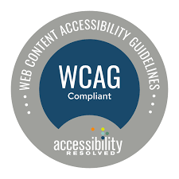
WCAG
W3C = World Wide Web Consortium
WCAG = Web Content Accessibility Guidelines
With W3C the goal is a single shared standard for web content accessibility Focusing on people with disabilities
Evolution: - WCAG 1.0 (1999) - 14 principles
- WCAG 2.0 (2008) - 12 guidelines
- WCAG for mobile (2015)
- WCAG 2.1 (2018) - +1 guideline; +17 success criteria
- WCAG 2.2 (2023) - +9 success criteria and 1 removed

Slide 5
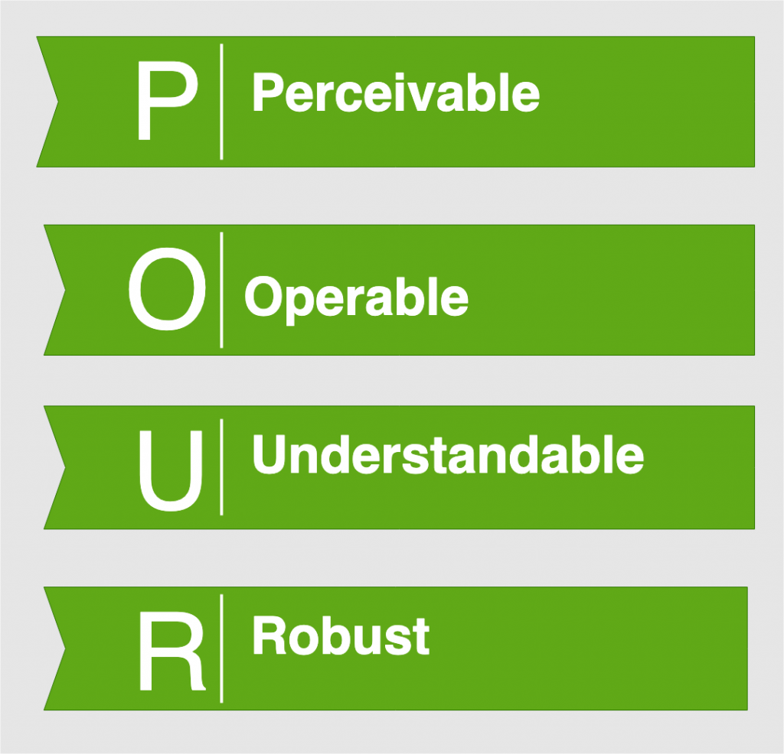
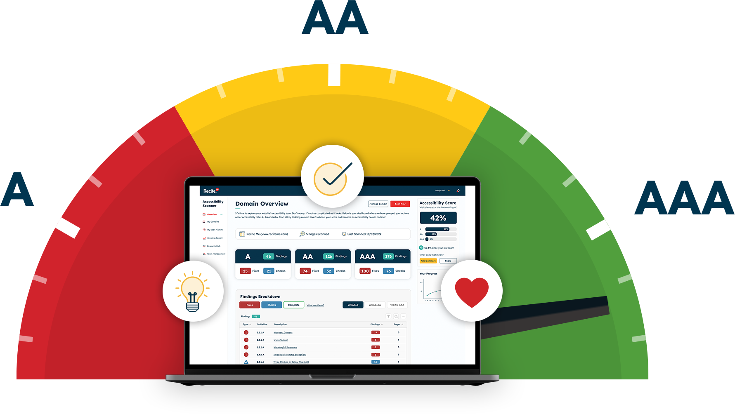
Organization and Principles
WCAG 2.2 - 13 guidelines and 86 success criteria
Organised under four principles:
User interfaces components and information must be delivered to users in ways they can perceive
Users must be able to operate the interface
Users must be able to understand the information as well as the operation of the user interface
Users must be able to access the content as technologies advance
Each success criteria:
‘A’ Conformance Priority 1
‘AA’ Conformance Priority 1 and 2
‘AAA’ Conformance Priority 1, 2 and 3

Slide 6
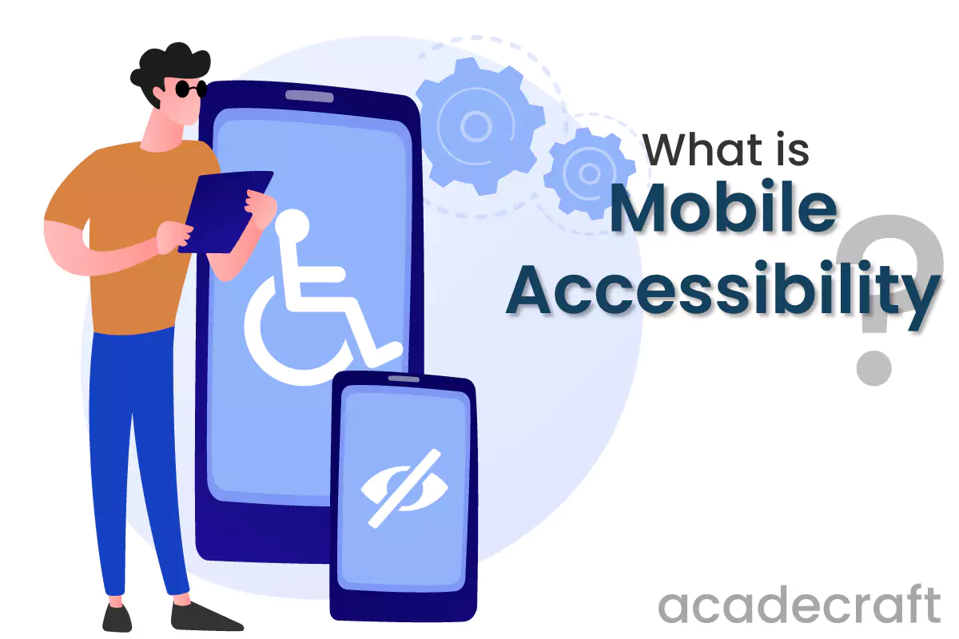
MCAG
MCAG = Mobile Content Accessibility Guidelines
An official document provided by W3C (2015)
Principles (same of WCAG) and guidelines applied to mobile context
Built for WCAG 2.0 WCAG 2.2
In the thesis guidelines adapted considering new success criteria of WCAG 2.1 and WCAG 2.2
Definition of new ideas for MCAG
VALID

Slide 7
New Ideas for MCAG
PERCEIVABLE
Typography: Using accessible fonts or the font of the system
Themes: Support both light and dark modes
OPERABLE
Voice Control: Ability to fully control the application using advanced voice commands
Customization and simplification of the interface
Action confirmations: Ensure clear and understandable confirmation
UNDERSTANDABLE
Action progress display: Clear and progressive indicators to understand the status
Avoid non necessary elements
Destination of the navigation buttons: Clearly distinguishable
Guided start-up tour: Guide user through main features and options available
ROBUST
Advanced feedback: More sophisticated and customizable feedback (facilitation)
Multilingual support: Application translated for all languages it makes available
Provide users enough time to read and use the content: Need to define timescales

Slide 8


Flutter and Dart
FLUTTER
Open source project conceived by Google in 2018
Last version 3.0 (2023)
Dart language
Compiles to native offering high performance
Easy to learn and performant
Free
Primarily used for Android and iOS applications
Composed of 3 layers
DART
Developed by Google in 2011
Aimed at replacing JavaScript
Type-safe
Two platforms: Dart Native and Dart Web

Slide 9

Application
RESEARCH QUESTIONS
RQ1: Are the elements and widgets provided by the framework accessible by default?
RQ2: If a element or a widget is not accessible by default, is it possible to make it accessible?
RQ3: If a element or a widget is not accessible by default, and can be made accessible by developers, how much does it cost in terms of additional required code?
TEST
Creation of the Application called ‘Flaccess’
Integrated Development Environment: Android Studio
Devices: Emulator and Android Google Pixel 7
Screen reader: TalkBack

Slide 10
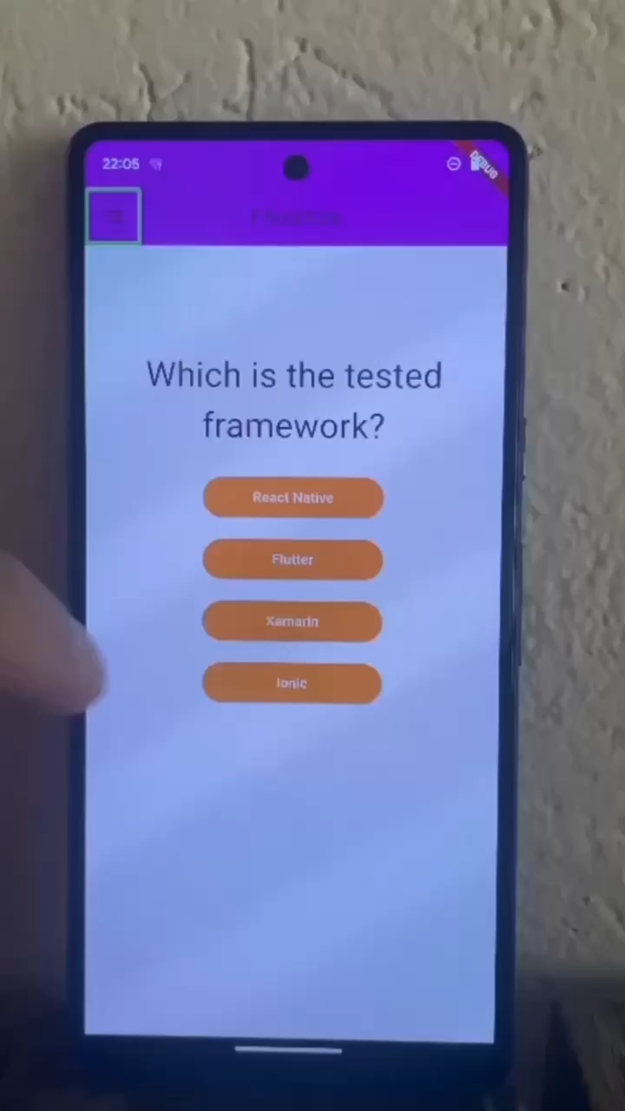
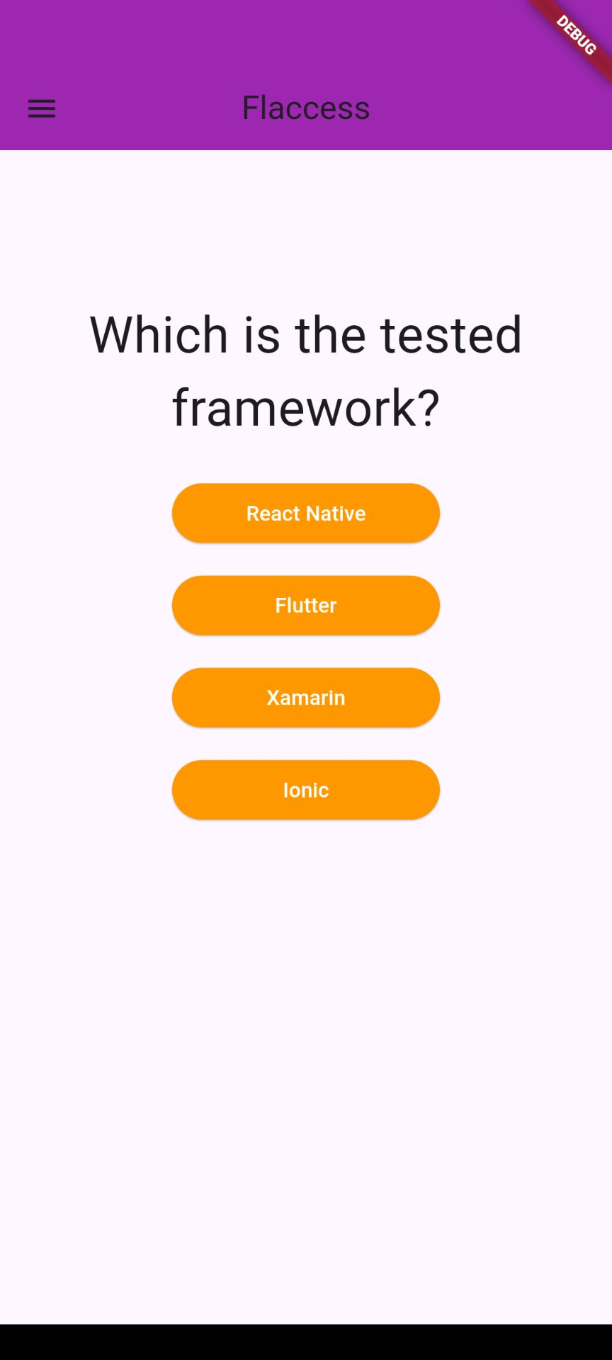
Implementation 1

Slide 11
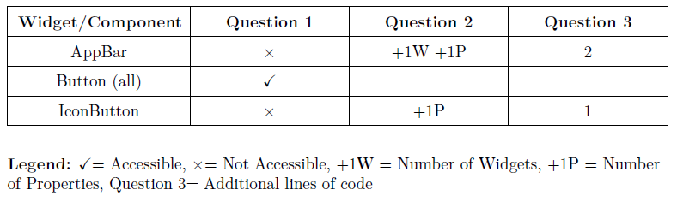
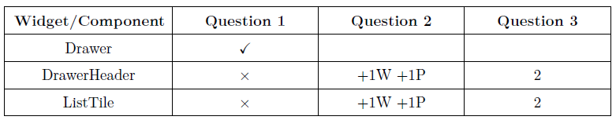
Implementation 1 Analysis

Slide 12
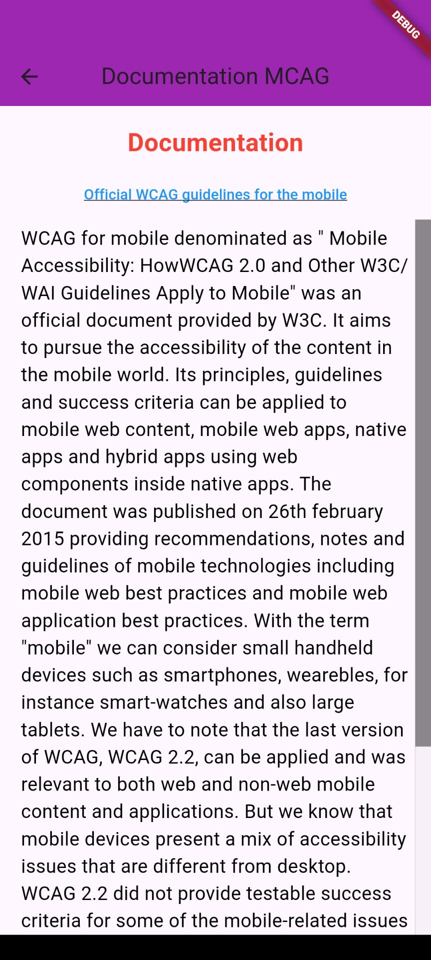
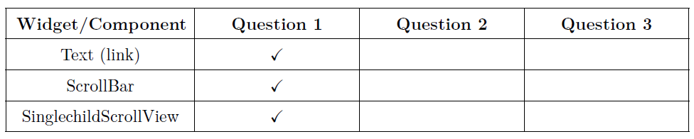
Implementation 2
ANALYSIS

Slide 13
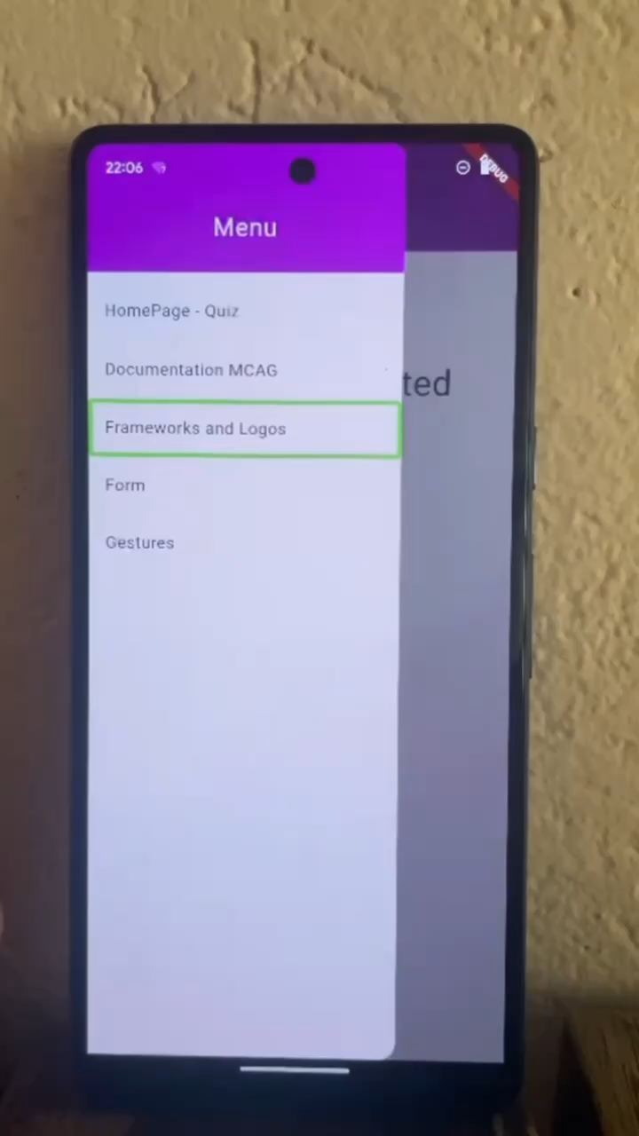
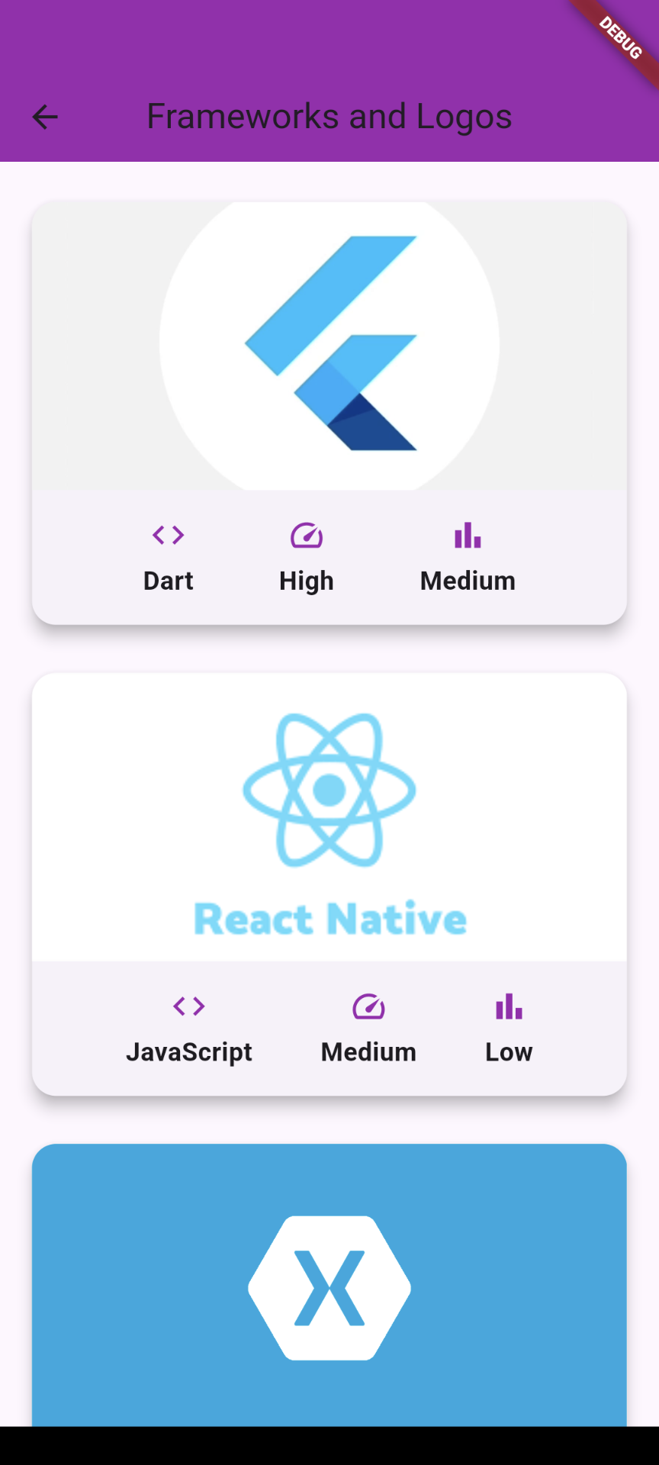
Implementation 3

Slide 14
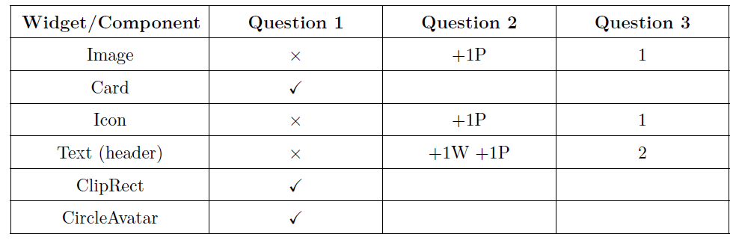
Implementation 3 Analysis

Slide 15
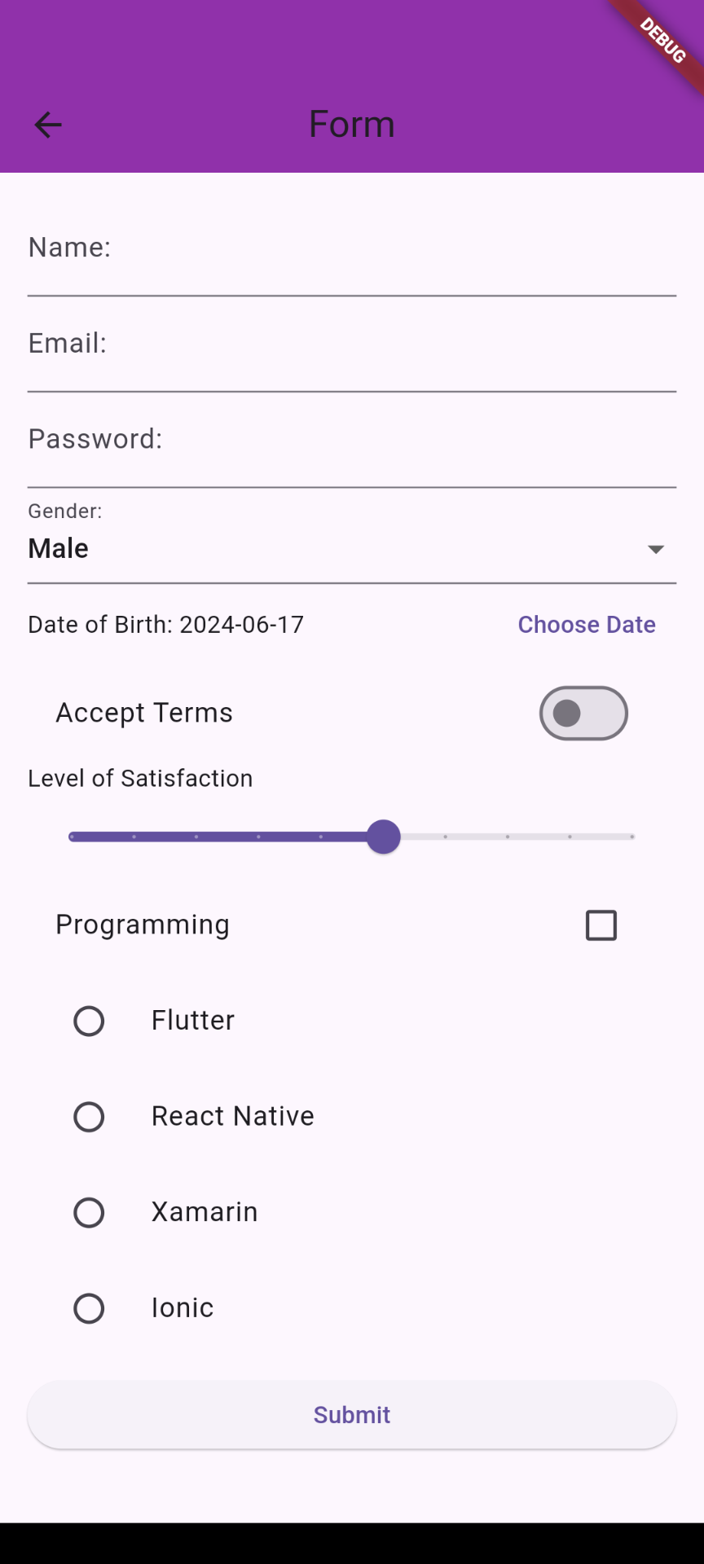
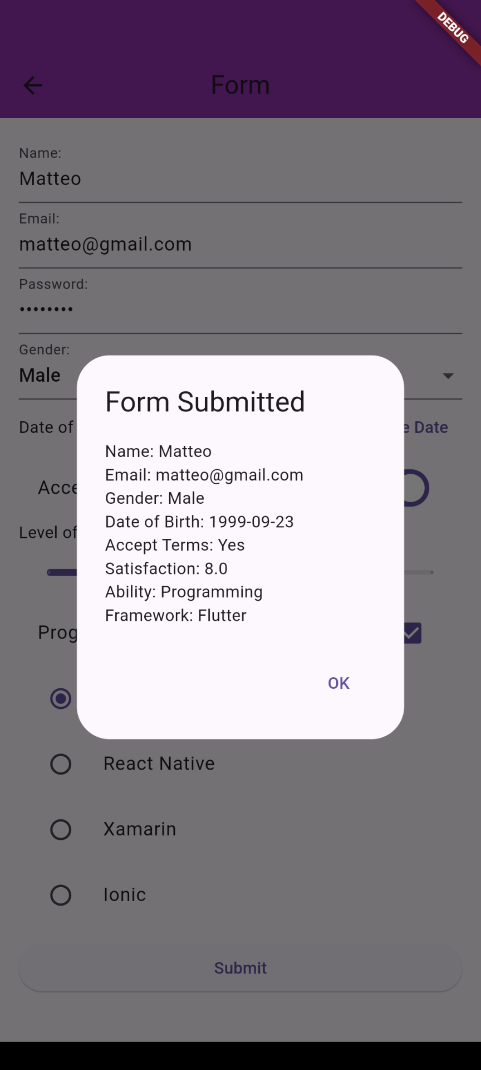
Implementation 4

Slide 16
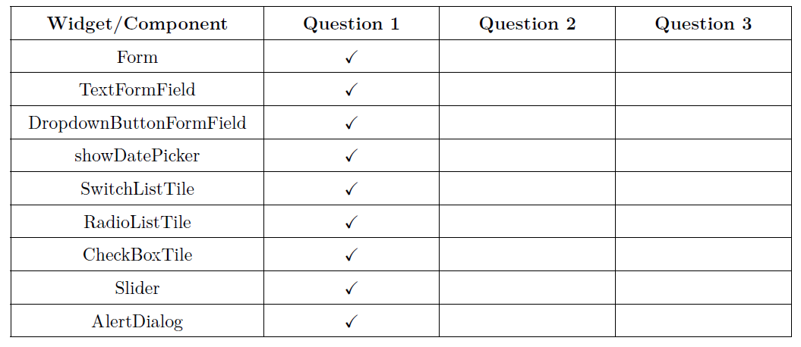
Implementation 4 Analysis

Slide 17
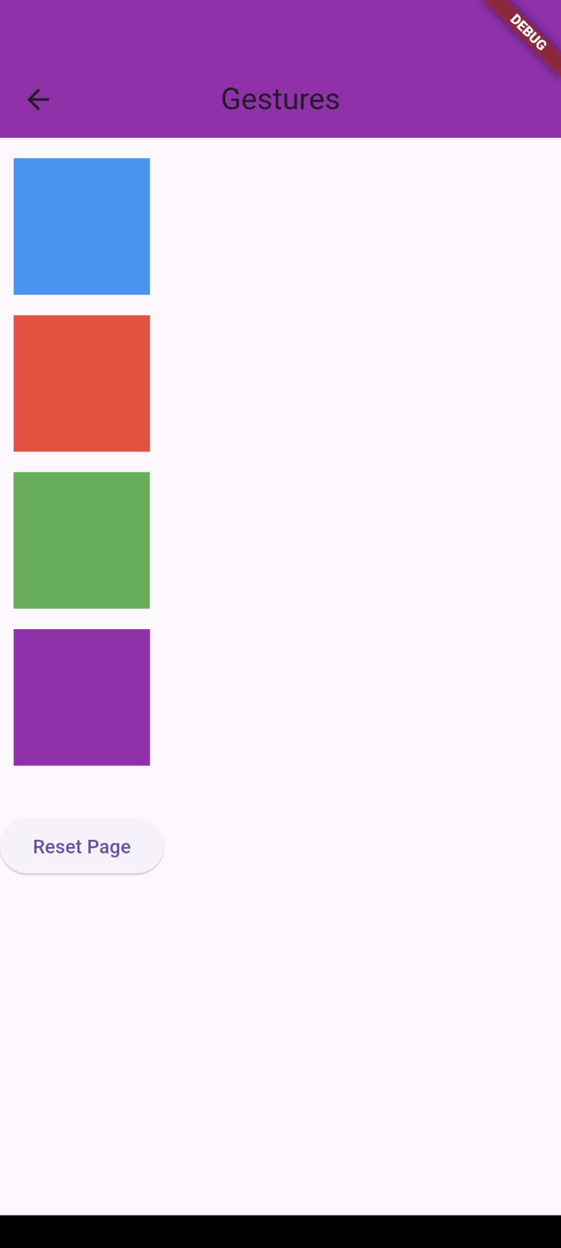
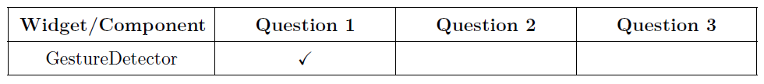
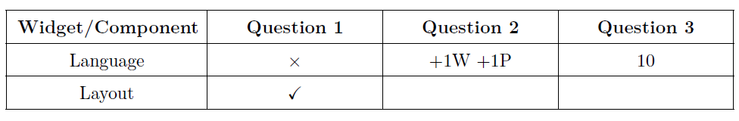
Implementation 5
ANALYSIS
OTHER CONSIDERATIONS

Slide 18

Conclusions
Mobile Content Accessibility Guidelines need an update and an apposite documentation
Most of the Widgets and Elements in Flutter are accessible by default
Developers can use the thesis as manual for creating Flutter mobile applications accessible to everyone

